Slide 1
User Interest Analysis In Twitter
Rajendra kumar VM
Pirasad T

Slide 2
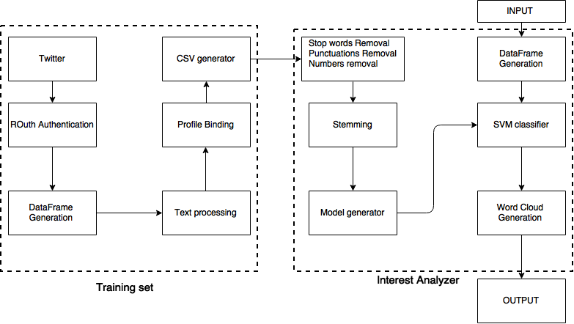
Block Diagram

Slide 3
Preprocessing Step
Upto 500 tweets per user can be retrevied by this process

Slide 4
CSV model Generation

Slide 5
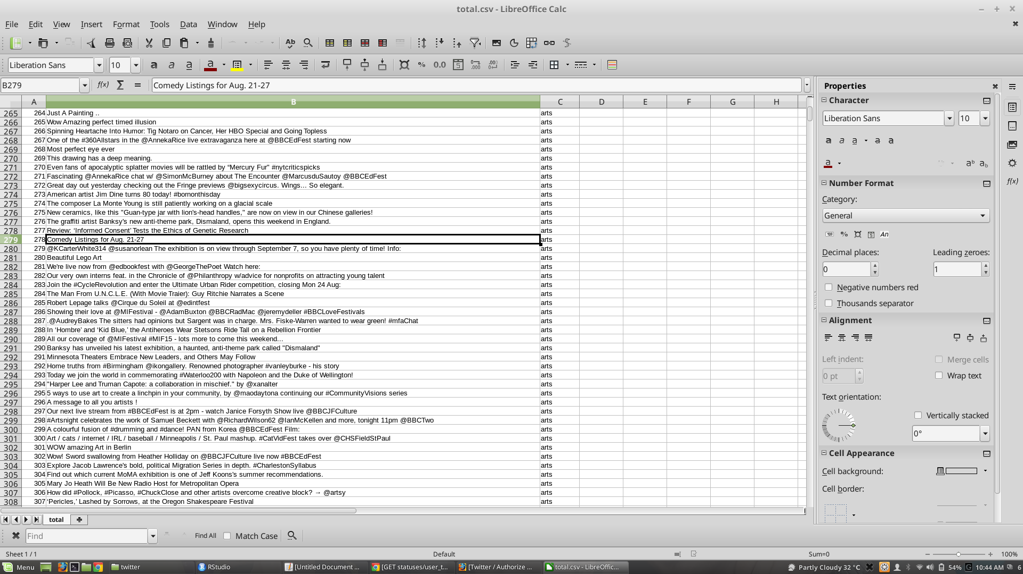
CSV Generation file

Slide 6
Intermediate Result Generation

Slide 7
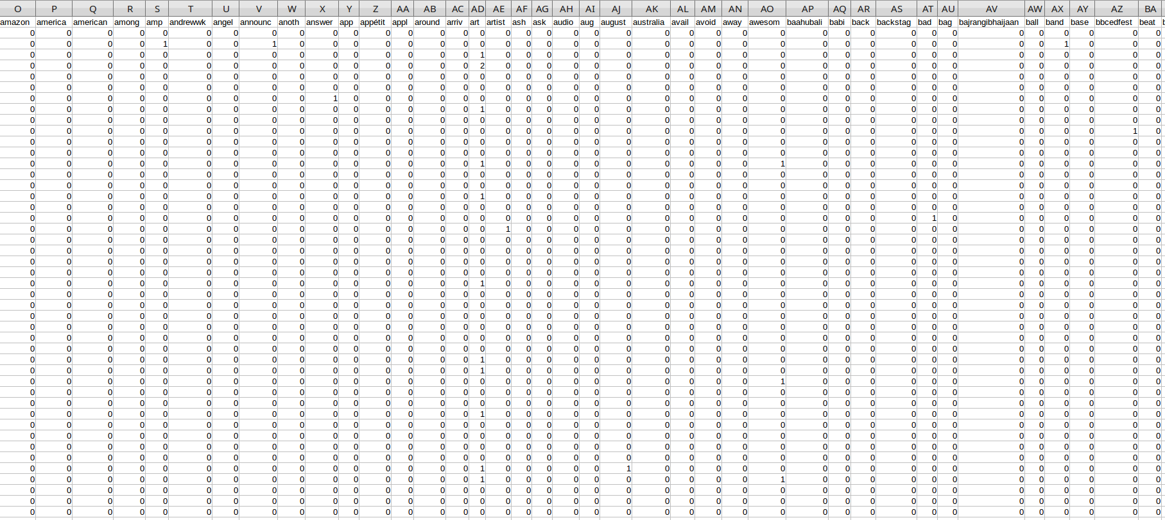
Intermediate Output 50% implementation

Slide 8
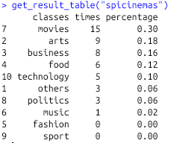
Statistical data

Slide 9
Final implementation

